Slide 1
Remaining GRASP Patterns and Then GoF Patterns
Lect 19--20
9-10-2023

Slide 2
GRASP Patterns
GRASP patterns essentially suggest how to assign responsibilities to classes:
  Warning: Some Grasps tend to be vague and need to be seen as guidelines rather than solutions.
What is a responsibility?
  A contract or obligation of a class
  Responsibilities can include behaviour, data storage, object creation, etc.
  Usually fall into two categories:
    Doing
    Knowing

Slide 3
Law of Demeter
1
*
Bill
Item
ItemSpec
Problem:
How to avoid a class from interacting with indirectly associated classes?
Solution:
If two classes are not directly aware of each other:
  Then these two classes should not directly interact.
computeTotal
getItemSpec
findPrice

Slide 4
Collaborators

Slide 5
Law of Demeter
In a method implementation, messages should only be sent to the following objects:
  This object (or self)
  An object parameter of the method
  An object attribute of self
  An object of a collection which is an attribute of self
  An object created within the method

Slide 6
LD Violation: Hypothetical example
class A {
private B b = new B();
public void m() {
this.b.c.foo();
}
}
class B {
C c;
}
class C {
public void foo() {
}
}

Slide 7
Law of Demeter: Check Violation
Bill
1
*
Item
ItemSpec
computeTotal
getItemSpec
findPrice
Violation: item.getItemspec().findprice()
1
*
Bill
Item
ItemSpec
computeTotal
computeSubtotal
findPrice
Solution

Slide 8
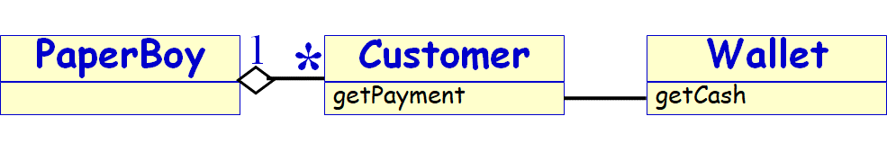
LoD Programming Style
In a class PaperBoy,
  do not use customer.getWallet().getCash(due);
  rather use customer.getPayment(due); and in customer.getPayment (due), use wallet.getCash(due)
Benefit:
  Easier analysis and maintainability
Tradeoff:
  More statements, but smaller/easier stmts
Experiments show significantly improved maintainability.

Slide 9
The Law of Demeter: “Do not talk to strangers”
Don’t send messages to object refs returned from other method calls
public void movePlayer(int roll) {
...
if (currentPlayer.square().isLastSquare()) {
winner = currentPlayer;
}
}
public void movePlayer(int roll) {
...
if (currentPlayer.wins()) {
winner = currentPlayer;
}
}
Better
Notes:
Karl J. Lieberherr, et al. Object-Oriented Programming: An Objective Sense of Style. In Proceedings OOPSLA '88.
The Law of Demeter states that you should only send messages to: an argument passed to you; an object you create; self, super; or your class.
By obeying this law, you avoid unnecessarily coupling your classes. Instead of retrieving data from other objects, you should delegate tasks to them.
Alec Sharp in Smalltalk by Example, McGraw-Hill, 1997, explains this as “Tell, don’t ask”

Slide 10
Law of Demeter: Final Analysis
Reduces overall coupling in the design
Adds a small amount of overhead in the form of indirect method calls

Slide 11
“The basic effect of applying the Law of Demeter is the creation of loosely coupled classes, whose implementation secrets are encapsulated. Such classes are fairly unencumbered, meaning that to understand the working of one class, you need not understand the details of many other classes.” Grady Booch

Slide 12
Polymorphism Pattern
Problem:
  How to handle alternative operations based on subtypes?
Solution:
  When alternate behaviours are selected based on the type of an object,
  Use polymorphic method call to select the required behaviour,
  Rather than using if statement to test the type.
Notes:
polymorphism
has definition A property of object oriented software by which an abstract operation may be performed in different ways in different classes
exists when several classes which each implement the operation either have a common superclass in which the operation exists, or else implement an interface that contains the operation
gets power from dynamic binding
is one of the fundamental features of the object oriented paradigm
dynamic binding
has definition The process of binding a call to a particular method. This is performed dynamically at run-time due to the presence of polymorphism
gives power to polymorphism
is needed when the compiler determines that there more than one possible method that could be executed by a particular call
is a kind of process
prevents programmers from having to write conditional statements to explicitly choose which code to run

Slide 13
AbstractSuperclass
commonOp1
commonOp2
…
variantOp1
variantOp1
…
variantOp1
variantOp1
…
variantOp1
variantOp1
…

Slide 14
Polymorphism : Example
Payment
amount
CashPayment
CreditPayment
CheckPayment
authorize()
authorize()
authorize()
By Polymorphism, each
payment should
authorize itself
Notes:
In the point -of -sale application, who should be responsible
for authorising different kinds of payments?
– Note: Payments may be in
• cash (authorising involves determining if it is
counterfeit)
• credit (authorising involves communication with bank)
• check (authorising involves driver license record)

Slide 15
Polymorphism Pattern: Advantage
Easily extendible as compared to using explicit selection logic…
Notes:
Lessons from Polymorphism
• Future extensions required for unanticipated new
variations are easy to add.
• Avoid “case /switch” statements or “if” conditionals on
type.
• The objects work on themselves
– Example: payments authorise themselves
• Also known as: “Do it myself”, “Choosing Message” and
“don’t ask ‘what kind?’”

Slide 16
GoF Patterns

Slide 17
What problems do GoF DPs solve?
Good designs need to cope with change. Why?
  Underlying technologies change
  Business goals change
  User expectations change
How to cope with change?
  Encapsulation
  Inheritance
  Polymorphism

Slide 18

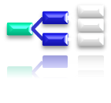

GoF Pattern Classification
Creational | Structural | Behavioral
Abstract Factory | Adapter Proxy | Visitor Command
Factory method | Bridge | Iterator
Builder | Composite | Mediator
Object pool | Decorator | Memento
Prototype | Façade | Observer
Singleton | Flyweight | State
Multiton |  | Template

Slide 19



Classification of Other Patterns
Concurrency | J2EE | Architectural
Active Object | Business Delegate | Layers
Balking | Composite Entity | Presentation-abstraction-control
Double checked locking | Composite View | Three-tier
Guarded suspension | Data Access Object | Pipeline
Monitor object | Fast Lane Reader | Implicit invocation
Reactor | Front Controller | Blackboard system
Read/write lock | Intercepting Filter | Peer-to-peer
Scheduler | Model-View-Controller
Event-Based Asynchronous | Service Locator | Service-oriented architecture
Thread pool | Session Facade | Naked objects
Thread-specific storage | Transfer Object

Slide 20
GoF Patterns: A Classification
Creational patterns:
  When and how objects are instantiated?
Structural patterns:
  How objects are composed into larger groups?
Behavioral patterns:
  How are responsibilities distributed?

Slide 21
GoF Pattern Taxonomy
Structural Patterns
  Adapters, Bridges, Facades, and Proxies are variations of a single theme:
    Reduce the coupling between two or more classes
    Introduce abstract classes to enable future extensions
Behavioral Patterns
  Assignment of responsibilities among objects: Who does what?
  Behavioral patterns concern cohesion and coupling.
Creational Patterns
  Separate a system from how its objects are created
  Increase the system's flexibility in terms of object creation.

Slide 22
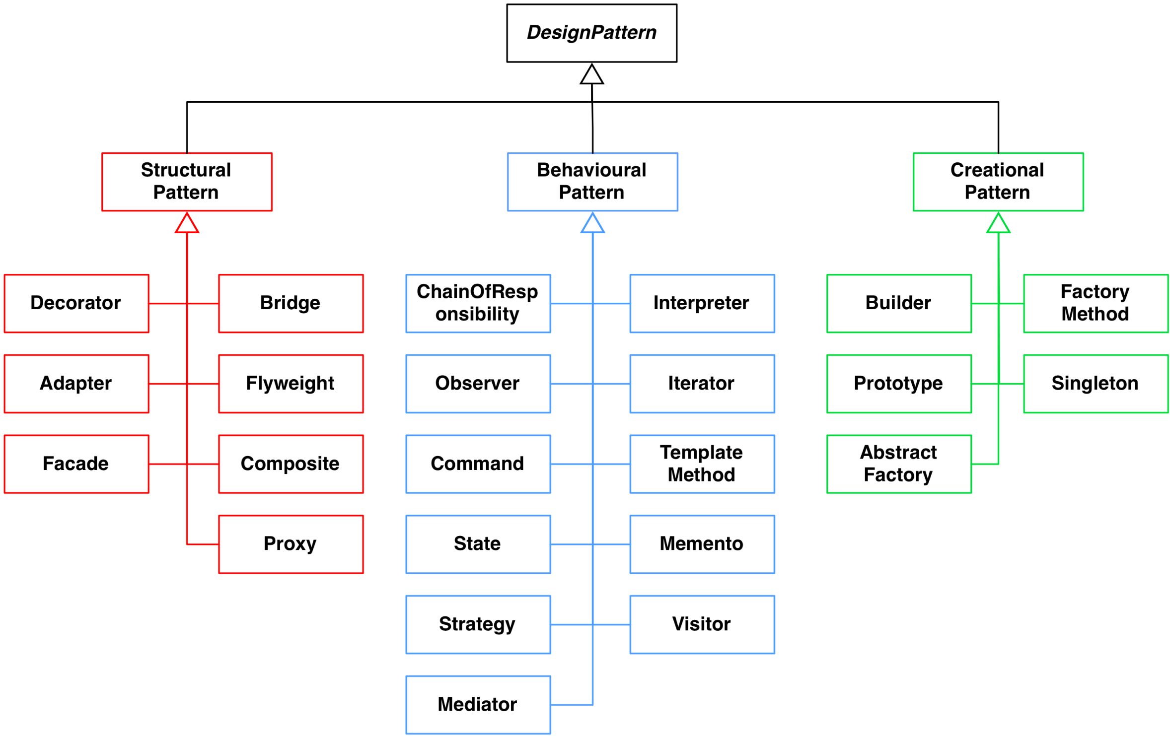
Taxonomy of GoF Patterns (23 Patterns)

Slide 23
Facade Pattern

Slide 24
Facade Pattern
Problem: How to avail services from a large number of classes present in a package?
Context: A package is a cohesive set of classes:
  Example: RDBMS interface package
Solution: A facade class (e.g. DBfacade) is created to provide a common interface to the services offered by the package.
DBA

Slide 25
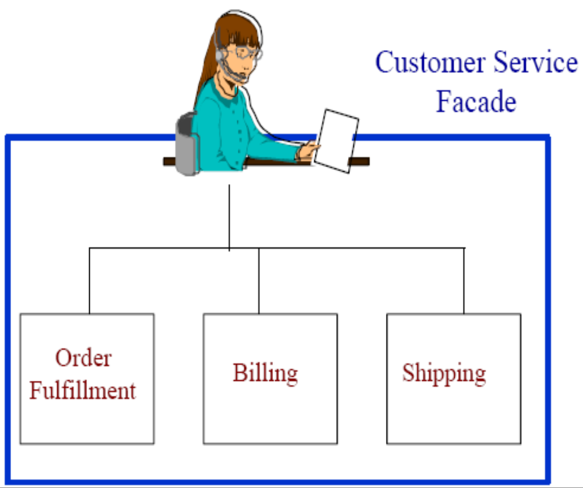
Facade (Non software example)
Provides a unified
interface to a set
of classes in a
system.
  Ordering
Billing
Shipping

Slide 26

Overview of Facade
R1
R2
R3
R1
R2
R3
Service Package
Service Package
S1
S2
S1
S2
S3
S4
S3
S4
R4
R5
R4
R5
(a) Service invocation without a façade
(b) Service invocation using a façade class

Slide 27
Before and After Using Facade
Client A
Client B
DBQ
Client A
Database Facade
DBW
Client B
DBR
DBQ
DBW
DBR
Before Facade
After Facade

Slide 28
Facade: Structure
Package
Facade
subsystem classes
A
B
C
E
D
F
G

Slide 29
Facade Pattern: Example
Compiler
Compile()
Scanner
Token
CodeGenerator
Parser
ProgNodeBuilder
RISCCG
ProgNode
StackMachineCG
Statement Node
Expression Node
Compiler Subsystem Classes
Variable Node

Slide 30
Pattern Name
Security
<<façade>>
SecurityManager
+addAccessRight()
+addActor()
+addActorRole()
+removeActor()
AccessRight
+addAccessRight()
ActorRole
+addActorRole()
ActorManage
+addActor()
+removeActor()
+checkSalary()
Method not in Facade

Slide 31
Façade: Bank Example
User
Bank
AccountService
createAccount(…)
deposit(…)
withdraw(…)
Façade
TransactionService
createAccount(…)
deposit(…)
withdraw(…)
addTransaction(…)
applyForLoan(…)
addTransaction(…)
LoanService
applyForLoan(…)
…

Slide 32
Façade: Bank Example
public class BankFaçade {
private AccountService accountService;
private TransactionService transactionService;
private LoanService loanService;
public addAccount(Account account) {
accountService.addAccount(account);
}
public deposit(int accountId, float amount) {
accountService.deposit(accountId, amount);
}
public withdraw(int accountId, float amount) { accountService.withdraw(accountId, amount);
}
public addTransaction(Transaction tx) { transactionService.addTransaction(tx);
}
public applyForLoan(Customer cust, LoanDetails loan) { loanService.apply(cust, loan);
}
}

Slide 33
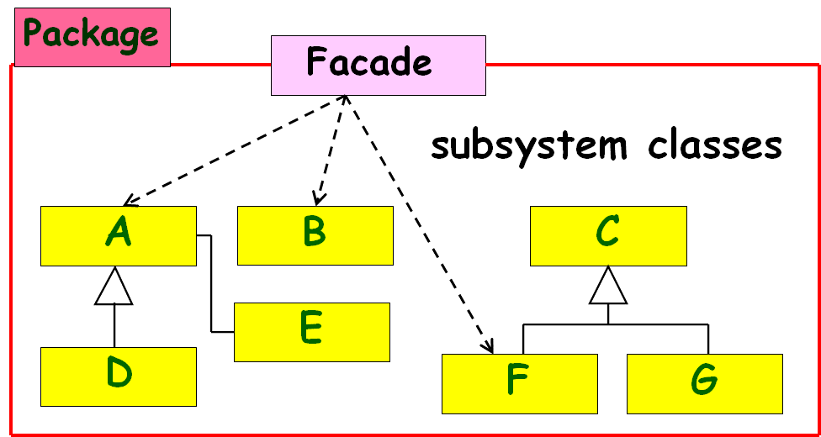
Discussions on Façade Pattern
Clients communicate only with the Façade:
  Façade forwards each request to the appropriate subsystem object(s).
  Results in lowering overall coupling; clients need to know only about the Façade.
Façade often does little more work than simply delegating requests to other classes inside the package!

Slide 34
Discussions on Façade Pattern
Although subsystem objects perform actual work:
  Façade may have to translate between subsystem interfaces.
Clients are aware of only the Façade:
  Don’t have to directly access the other objects in the package.

Slide 35
Model-View Separation Patterns

Slide 36
Model-View Separation Patterns --- Background
Symptom of Poorly designed GUIs:
  Classes with a large and incoherent set of responsibilities:
  Encompass: GUI, Listening to events, domain logic, application logic, etc...
We should separate the concerns.
  Model and view objects
  How should they communicate?
View
Model

Slide 37
Model View Separation Patterns
Problem:
  How should the non-GUI classes communicate with the GUI classes and vice versa?
Solution:
  Several solutions exist --- each appropriate in a different context.

Slide 38
Simplistic Model View Communication
Subject or Model
Subject
Interface
XML
xyz…
Observers
Web
Browser
PDA
Cell
Phone
Terminal
View objects

Slide 39
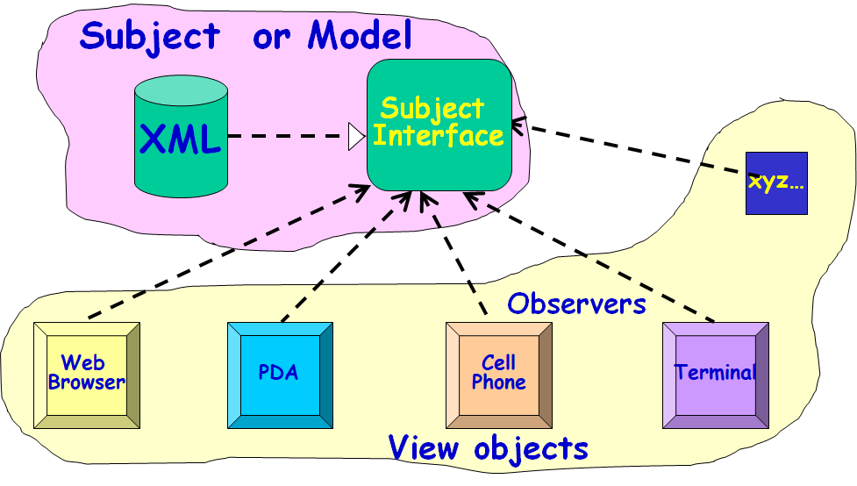
Model View Separation Patterns: Simple Solution Overview
Model objects should not invoke services of view objects…
  Vice-versa is OK, Why?
  View objects are transient
  Reuse, extension, maintenance are easier.
  A change to a view object does not require change to the model object.

Slide 40
  Solution 1: Pull from Above
Most obvious solution:
  View (boundary) objects directly invoke model objects.
Problem:
  Views can become inconsistent
  View objects do not know when model state changes
  How do users change the model?
Subject or Model
XML
Subject
Interface
xyz…
Web
Browser
PDA
Cell
Phone
Terminal

Slide 41
Obvious Solution
Subject or Model
Subject
Interface
XML
xyz…
Web
Browser
PDA
Cell
Phone
Terminal
Observers
Data is polled by various observers

Slide 42
Contexts in Which Pull from Above Does Not Work
Data changes asynchronously:
  Events in a simulation experiment, stock market alerts, network monitor events...
Some clients can change the model:
  In a computer game, a mouse event by a player to make a move.

Slide 43
Model-View Separation Solutions
Pull from above:
  Does not work when model changes asynchronously
Observer pattern: (GoF)
  Multiple independent observers
Model-View Controller Pattern:
  Multiple independent observers
  Multiple independent controllers
Publish-subscribe pattern:
  Large number of observers
  Multiple models elements
  Different observers interested in different classes of events

Slide 44
Observer Pattern: Problem
When a model object changes state asynchronously and is accessed by several view objects:
    How should the interactions between the model and the view objects be structured?
Solution: Define a one-to-many dependency, so that when model changes state, all of its dependents are notified and updated automatically.

Slide 45
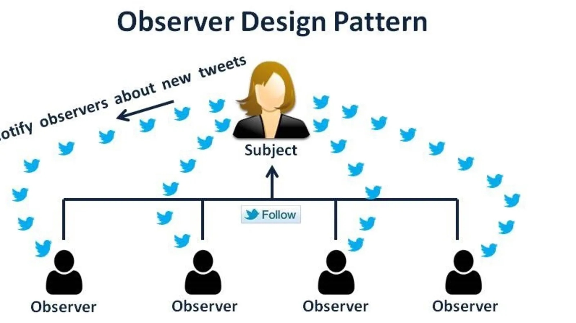
Observer Pattern: Context
There could be many observers:
  Also the number of observers may vary dynamically
  Each observer may react differently to the same notification…
Subject (model) should be as much decoupled from the observers as possible:
  Allow observers to change independently of the subject…

Slide 46
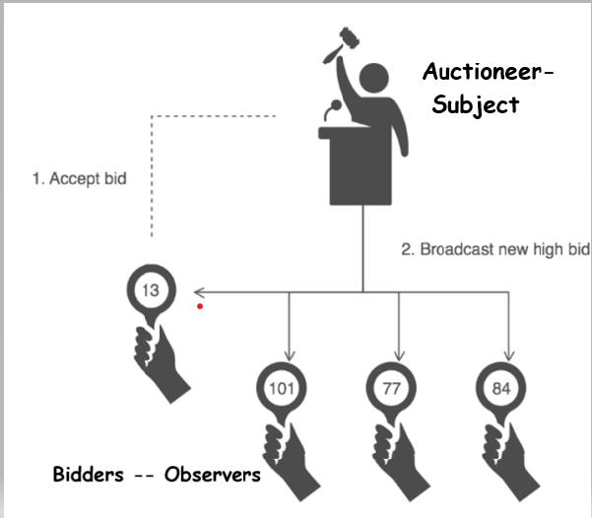
Observer (Non software example)
When present highest bid object
changes its state,
all its dependents
are notified.

Slide 47
Example 1: Stock Quote Service
Real time
Market Data
Feed
Stock market
Stock Quotes
A
A
A
B
D
Customer
C
Customer
C
Customer
Customer
Customer
Observers

Slide 48

Example 2: Cricket Match
Internet
Cricinfo Server

Slide 49
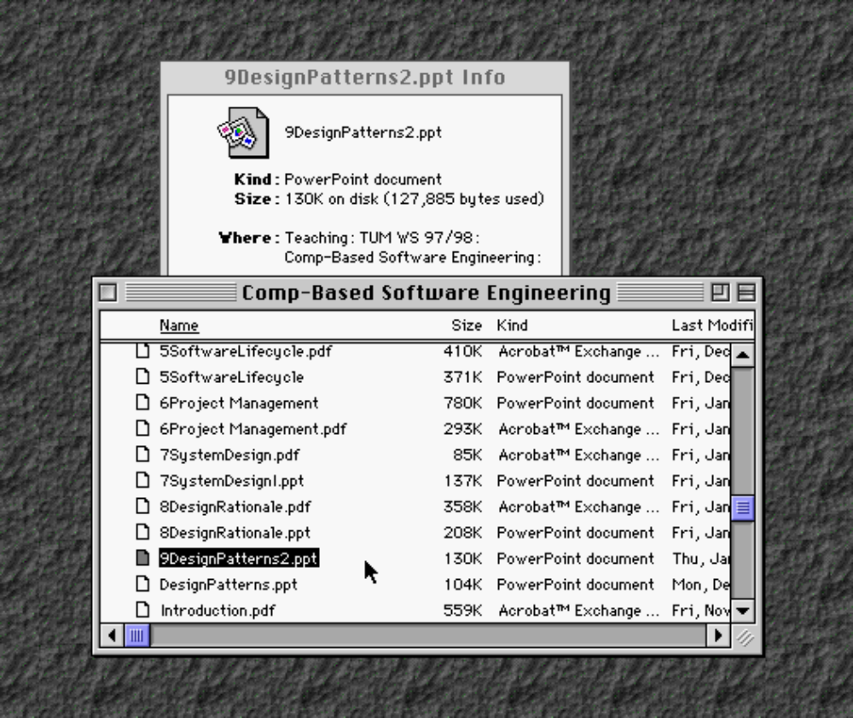
Example 3: File Listing
Observers
Subject
DesignPattern.ppt

Slide 50
Observer Pattern
When observable (model) changes state:
  All dependent objects are notified --- these objects then update themselves.
  Allows for consistency between related objects without tightly coupling the classes.

Slide 51
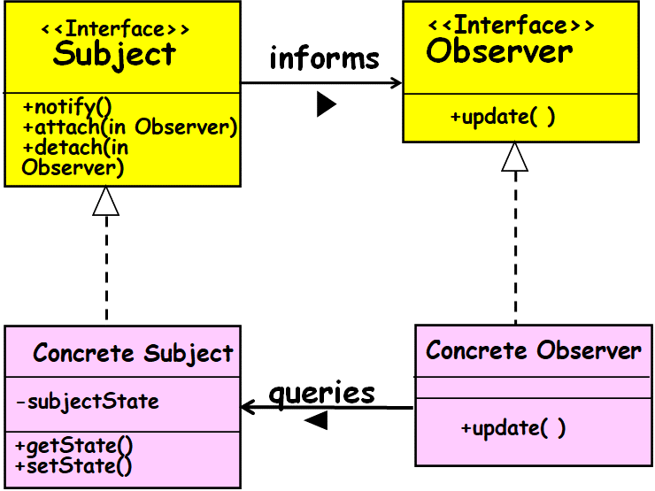
Observer Pattern: Solution
Observers need to register themselves with the model object.
  The model object maintains a list of the registered observers.
When a change occurs to a model object:
  Model notifies all registered observers.
  Subsequently, each observer queries the model object to get any specific information about the changes.

Slide 52
Key Players
Subject Interface
  Knows its observers – provides interface for attaching/detaching subjects
Observer Interface
  Defines an interface for notifying the subjects of changes to the object.
ConcreteSubject
  Inplements subject interface to send notification to observers when state changes
ConcreteObserver
  Implements Observer interface to keep state consistent with subject

Slide 53
Structure of Observer Pattern
<<Interface>>
Subject
<<Interface>>
Observer
inform
+notify()
+attach(iObserver)
+detach(Observer)
+update( )
for all observer obs
{
obs.update();
}
Concrete Subject
Concrete Observer
query
-subjectState
+update( )
+getState()
+setState()
observerState = subject.getState();
return subjectState

Slide 54
Observer Pattern
Defines a many-to-one dependency between objects:
  When subject changes state, all its dependents are notified and they update themselves.
Effectively decouples the subject from the observer:
  But, subject has little information about needs of the observer.
  Can result in excessive notifications.

Slide 55
Working of Observer Pattern
  ConcreteSubject notifies its observers:
    Whenever a change makes its state inconsistent with the observers.
After being informed of change:
  A ConcreteObserver queries the subject to reconcile its state with subjects.

Slide 56
Observer Pattern
Subject
<<Interface>>
attach(observer)
detach(observer)
notify()
Observer
<<Interface>>
update()
observers
*
subject
ConcreteObserver
update()
observerState
ConcreteSubject
getState()
setState(newState)
subjectState
The Subject represents the actual state,
  The Observers represent different views of the state.

Slide 57
Animated Sequence diagram
aFile
anInfoView
aListView
Attach()
Attach()
notify()
update()
update()
getState()
“foo”

Slide 58
Activities of Update
ConcreteObserver.Update():
  Check for exceeding some threshold, etc.
  Repaint the user interface
  These are operations that might have cluttered up a domain class (Subject).

Slide 59
Observer Implementation
A Subject class usually maintains:
  An ArrayList of ids of registered Observers
  Makes it easier when any random object wants to attach or detach

Slide 60
Observer Pattern Implementation in Java
public interface Observer {
public void update(Subject o );
}
Public interface Subject {
public void addObserver(Observer o);
public void removeObserver(Observer o);
public String getState();
public void setState(String state);
}

Slide 61
Subject
Observer
*
attach(Observer)
detach(Observer)
notify()
Update()
for all o in
observers {
o.update( ) }
ConcreteObserver
ConcreteSubject
observerState
update()
subjectState()
getState()
setState()
*
return
subjectState
observerState =
subject.getState( )

Slide 62
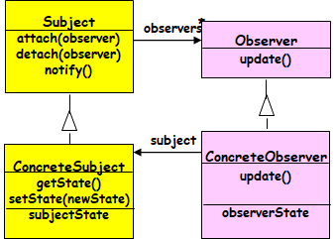
class ConcreteObserver implements Observer {
private String state = "";
public void update(Subject o) {
state = o.getState();
System.out.println("Update received from Subject, state
changed to : " + state);}
}
class ConcreteSubject implements Subject {
private List observers = new ArrayList();
private String state = "";
public String getState() {
return state;}
public void setState(String state) {
this.state = state;
notifyObservers();}

Slide 63
public void addObserver(Observer o) {
observers.add(o);}
public void removeObserver(Observer o) {
observers.remove(o);}
public void notifyObservers() {
Iterator i = observers.iterator();
while (i.hasNext()) {
Observer o = (Observer) i.next();
o.update(this);}
}

Slide 64
Inbuilt Java Observers
Support for the Observer pattern is built into Java language.
interface Observer {
void update(Observable o, Object arg);
} //java.util.Observer
class Observable {
void addObserver(Observer o) { … }
void deleteObserver(Observer o) { … }
void notifyObservers(Object arg) { … }
} //java.util.Observable base-class

Slide 65
Java Observer/Observable
Observers register with Observable
Observable recognizes events and calls specified method of observers
Java Observer
  Interface class, implemented by observers
Java Observable
  Concrete Class

Slide 66
Java Observer Class
Must implement an update() method which the Observable object x will call:
  update(Observable x, Object y)
When Observable object x calls the update() method for a registered observer:
  It passes itself as a parameter and also a data object y…

Slide 67
Java Observable Class
Needs to be extended
Inherited methods from Observable
  addObserver(Observer z)
    Adds the object z to the observable’s list of observers
  notifyObserver(Object y)
    Calls the update() method for each of the observers in its list of observers, passing y as the data object

Slide 68
Java Support for Observer Pattern
interface Observer {
  void update (Observable sub, Object arg)
}
Subject.
class Observable {
…
}
  public void addObserver(Observer o) {}
  public void deleteObserver (Observer o) {}
  public void notifyObservers(Object arg) {}
public boolean hasChanged() {}

Slide 69
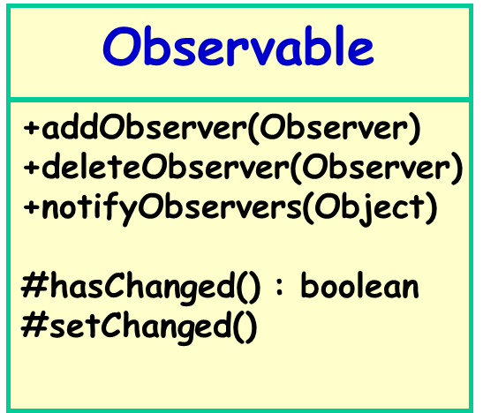
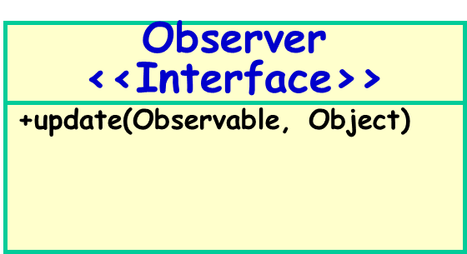
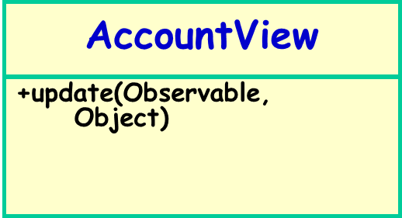
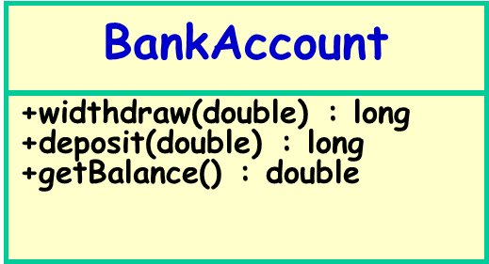
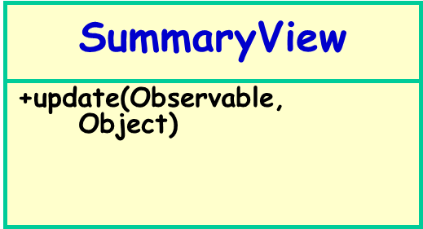
Bank Example: Observer Class Diagram

Slide 70
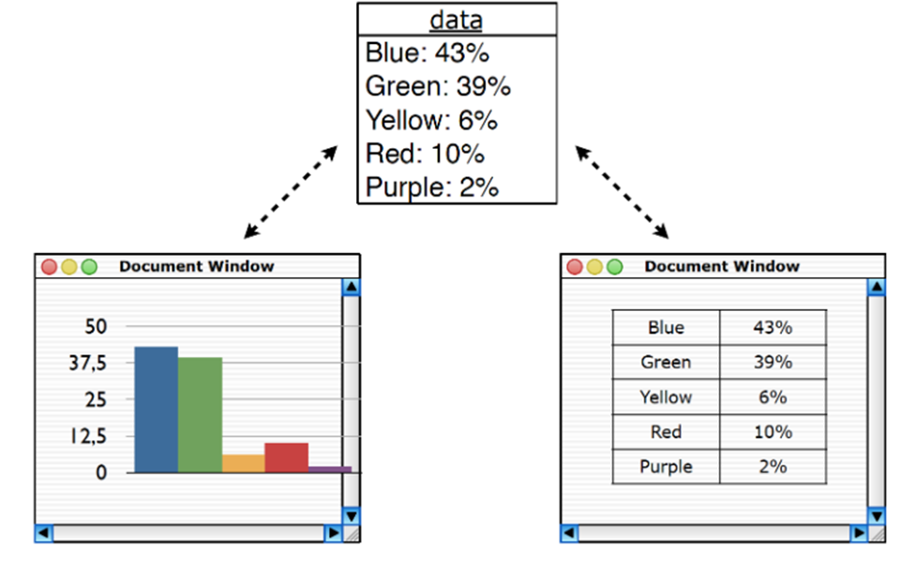
Observer Pattern- Implementation Example 2
public PiChartView implements Observer {
  void update(Observable sub, Object arg) {
  // repaint the pi-chart
  }
}
A Concrete Observer.
class StatsTable extends Subject{
public boolean hasChanged() {
// override to decide when it is considered changed
}
}

Slide 71
Observer Pattern - Consequences
Effectively removes coupling between subject and observer:
  subject need not know concrete observers
Support for broadcast communication:
  All observers are notified
Supports asynchronous updates:
  Observers need not know when updates occur

Slide 72
Observer Pattern - Consequences
Consequences
  Modularity: subject and observers may vary independently
  Extensibility: can define and add any number of observers
  Customizability: different observers provide different views of subject
Implementation Issues
  Subject-observer mapping
  Dangling references

Slide 73
Some Limitations of Observer Pattern
Model objects incur substantial overhead:
  To handle registration of the observers,
  To respond to queries from observers.
Performance concerns:
  Especially when the number of observers is large…

Slide 74
Observer Pattern
Indications:
  Asynchronous update of model elements
  Observer and model states need to be consistent all the time
  Number of observers can change dynamically

Slide 75
Observer
Contra-Indications:
  Static data
  Fixed viewers

Slide 76
Java Observer Deprecated! Why?
It does not provide a rich enough event model for applications!
  For example, supports only the notion that something has changed, but does not convey any information about what has changed
Not threadsafe!
Programmers often make use of PropertyChangeListener instead:
  Which itself is an implementation of Observer pattern…

Slide 77

public class PCLBlog {
private String blogPostTitle;
private PropertyChangeSupport support;
public PCLBlog() {
support = new PropertyChangeSupport(this);
}
public void addPropertyChangeListener(PropertyChangeListener pcl) {
support.addPropertyChangeListener(pcl);
}
public void removePropertyChangeListener(PropertyChangeListener pcl) {
support.removePropertyChangeListener(pcl);
}
public void setBlogPostTitle(String value) {
support.firePropertyChange("blogPostTitle", this.blogPostTitle, value);
this.blogPostTitle = value;
}
}

Slide 78
Home Work
Provide class design for:
Blog application: Any one can enrol by providing e-mail. Any blog posted is communicated to the registered users.
Cricket application: Any one can enrol by providing e-mail. Any development (runs, out, over etc) posted is communicated to the registered users.

Slide 79

public class Blog extends Observable {
private List<Observer> subscribers = new ArrayList<>();
public void addBlogPost(String blogPostTitle) {
notifyObservers(blogPostTitle);
}
public void notifyObservers(String blogPostTitle) {
for (Observer subscriber : subscribers) {
subscriber.update(this, blogPostTitle);
}
}
public void registerObserver(Observer newSubscriber) {
this.subscribers.add(newSubscriber);
}
public void removeObserver(Observer previousSubscriber) {
this.subscribers.remove(previousSubscriber);
}
}

Slide 80
MVC: History
As compared to the Observer pattern:
  More appropriate in certain situations.
First developed by Xerox PARC for Smalltalk-80.
Used by the Application Kit system in NeXTstep.
  Used by the Cocoa APIs for Apple’s OS X.
It is the recommended structural framework for developing J2EE applications.

Slide 81
Subsequently…
A heavily used architectural design pattern…
The main theme of:
  Struts
  Ruby on Rails
  Java Server Faces (JSF)

Slide 82

Model-View-Controller (MVC) Pattern
Breaks an application into three parts:
  Model maintains data (State),
  View displays the data.
  Controller handles user events that may affect the model or views.
sees
Uses
View
Changes
Controller
Updates
Manipulates
Model

Slide 83
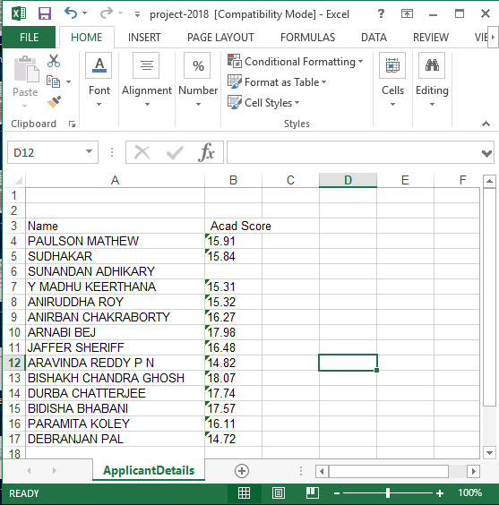

Slide 84
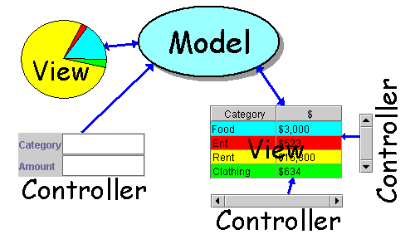
MVC Architecture
A typical application includes:
  Model: Maintain application data,
    Data in a spreadsheet, or
    state of a chess game -- positions of pieces
  View: Present output
    Data in table or pie chart or bar chart
    Graphical view of chess game
  Control: Handle user input
    key presses
    mouse click on controls

Slide 85
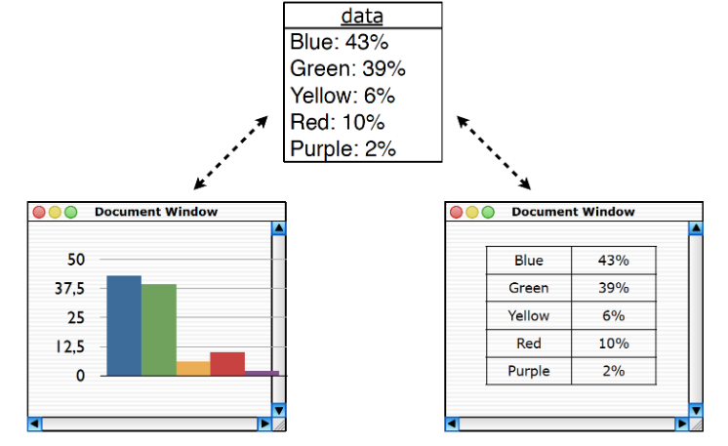
Dependency Among MVC Elements

Slide 86
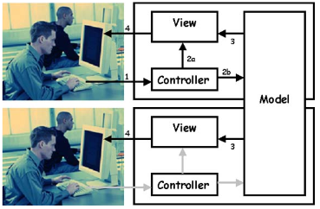
Multiple Views and Controls

Slide 87
MVC incorporates Observer Pattern!
Observer
+ update()
Model
-CoreData
-SetOfObservers
View
attach
-myModel
-myController
+attach(Observer)
+detach(Observer)
+notify()
+getData()
getdata
+initialize (Model)
+makeController()
+activate()
+display()
+update()
Controller
display
-myModel
-myView
detach
+initialize (Model, View)
+handleEvent()
+update()
attach

Slide 88
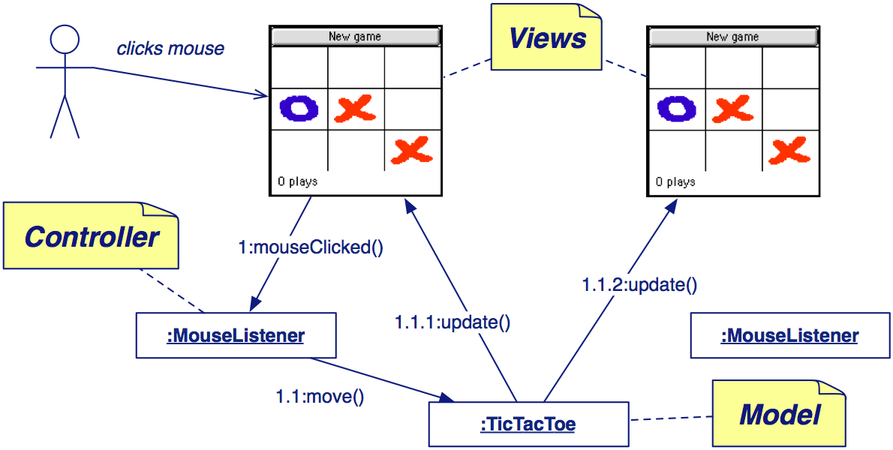
Model-View-Controller: Example

Slide 89
MVC in Web Application Development
Model: handles business logic
  Data retrieval & manipulation
  Including checking “Business Rules”
View: user interface (UI) component
  Front-end generation: html in browser
  The LOOK of the application
Control: deals creating with UI events
  Triggered by user using the UI
  The FEEL of the application

Slide 90
MVC: Another Example
View
Controller
Model
catalog
Customer
addItem
show
catalog
dbms
Shopping
cart
removeItem
checkout
Show
shoppingCart
Show
confirmation

Slide 91
aConcrete
Subject:
aConcrete
Controller:
aConcrete
Observer:
setState( )
notify( )
update( )
getState( )
update( )
getState( )

Slide 92
MVC Example: Word Processor
Control
Model
View
insertText
notify
getText
repaint

Slide 93
MVC Pattern in Java Swing
Swing uses the model-view-controller architecture (MVC) as the fundamental design behind each of its components. Essentially, MVC breaks GUI components into three elements. Each of these elements plays a crucial role in how the component behaves. The model encompasses the state data for each component. Robert Eckstein

Slide 94
Singleton Pattern

Slide 95
Recollect: Pattern Taxonomy
Pattern
Creational
Pattern
Structural
Pattern
Behavioral
Pattern
Singleton
Factory
Singleton
Command
Observer
Strategy
Adapter
Bridge
Facade
Proxy

Slide 96
Creational Patterns
Abstracts out the instantiation process.
Make system independent of creation of new objects:
  Objects created
  Possibly composed
Encapsulate knowledge about which concrete classes the system uses:
  Hide how instances of these classes are created and put together

Slide 97
Singleton Pattern: Problem
Ensure that a class has only a single instance.
Provide a global point of access to it.

Slide 98
Singleton Pattern: Example 1
Problem: A single object should maintain an application’s configuration.
Many objects may wish to read and update the configuration:
  How to restrict only one instantiation?
  A singleton class will ensure that all of the application’s objects can get the same copy of the game’s configuration…

Slide 99
Singleton Pattern: Example 2
Problem:
  How to control access to resources such as database connections or sockets?
Example: You have a license for only one connection for your database:
  A Singleton makes sure that only one connection is made.
  If you buy more licenses or use a JDBC driver that allows multithreading, the Singleton can be easily adjusted to allow more connections (Multiton).

Slide 100
Singleton: Example 3
Suppose you need a counter that gives out unique numbers (e.g. token numbers in a restaurant):
  First, the counter object needs to be unique.
  A Singleton counter can generate the numbers and synchronize access.

Slide 101
More Singleton Examples
One session manager per user session
One file system
One shopping basket per customer
One logger
One configuration object
One account per user,
Abstract factory and factory method, etc.

Slide 102
The Singleton Pattern
A Singleton is accessed by many objects in an application:
  Therefore should be easily and globally accessible --- Provide a global point of access to the object.
  Ensure that only one instance of a class is created ---Allow multiple instances when required.

Slide 103
Singleton Solution: Main Idea
Create an object with operation:
  getInstance()
When the class is first accessed:
  Singleton instance is created and the object’s identity is returned.
On subsequent calls to getInstance():
  No new instance is created,
  Id of existing object is returned.

Slide 104
The Singleton Pattern
A Singleton class itself is responsible for keeping track of its sole instance.
  How? --- intercept all requests to create new objects.
Singletons maintain a static reference to the sole singleton instance:
  Return a reference to that instance from a static instance() method.

Slide 105
Singleton Structure
Singleton
Object identifier for singleton
instance, class scope i.e. static
-uniqueInstance
-singletonData
Returns object identifier for
unique instance
+getInstance( )
+getSingletonData( )
+singletonOperation( )
-Singleton( )
Private constructor only accessible
via getInstance()
getInstance( ) {
if ( uniqueInstance == null )
{ uniqueInstance = new Singleton( ); }
return uniqueInstance;
}

Slide 106
:Client
Singleton
getInstance
:Instance Singleton
<<new>>
[instance has not been created]
instance
instance
Send messages to instance as appropriate

Slide 107
Singleton: Example Code
  Public Class Singleton {
  private static Singleton uniqueInstance = null;
  // Why is uniqueInstance static?
  private Singleton( ) { .. } // private constructor
  public static Singleton getInstance( ) {
  if (uniqueInstance == null)
  uniqueInstance = new Singleton();
  return uniqueInstance;
  }
  }

Slide 108
Exercise 1
Objects in a certain application:
  Get a Database Manager: DBMgr.getDBMgr();
It needs to be ensured that:
  There is only one Database Manager object.
  Need to disallow creation of more than one object of this class.

Slide 109
Exercise 1 -- Solution
class DBMgr {
private static DBMgr pMgr=null;
Private DBMgr() { } // No way to create outside of this Class
public static DBMgr getDBMgr() { // Only way to create.
if (pMgr == NULL) pMgr = new DBMgr();
return pMgr; }
public Connection getConnection(); }
}
Usage:
DBMgr dbmgr = DBMgr.getDBMgr();
//Created first time called

